Slide 1
Metaphor as Semantic Encryption:
Zero Knowledge Proof Using Dream of the Red Chamber as an Example
Lian, Zihe Zhao, Ayizuorehe
AI Thrust, Info Hub, HKUST(GZ)
xlian289@connect.hkust-gz.edu.cn

Slide 2
Agenda
Motivation
Crisis in digital creativity
Methodology
Similarity between metaphor and ciphertext
Combine Zero-knowledge proofs (ZKP) with system
Implementation
An example of Dream of the Red Chamber
Encryption and decryption of prophecies
Constraint system generation
Results
Zero knowledge proof process
Circuit performance
Applications
Notes:
Here’s our agenda:
First, I’ll disscuss our Motivation, which is the crisis in digital creativity.
Next is Methodology. We’ve found similarities between metaphors and ciphertexts, and we’re combining Zero - knowledge proofs (ZKP) to solve these problems.
Then, in Implementation, we’ll use Dream of the Red Chamber as an example to show how our ideas work in real - life, with encryption of prophecies and building a check system.
After that, Results will show our ZKP process and how well our system performs.
Let’s dive in.

Slide 3
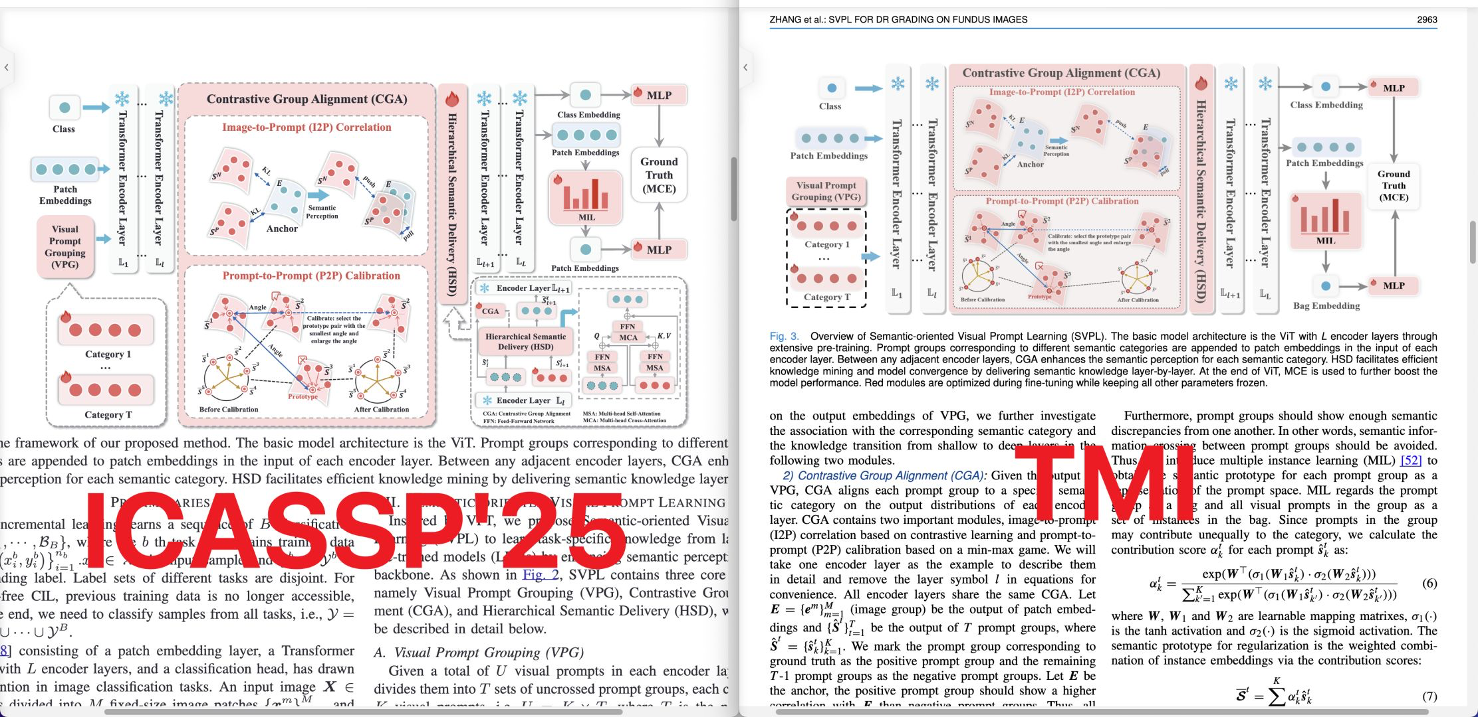

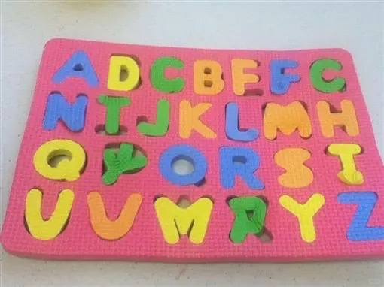
Unlocking creation
Dual Crisis in Digital Creativity
Encryption: Traditional methods secure content, but not creative value - texts “naked” during evaluation
Validation: Subjective judgments; no way to prove value without revealing content
Copyright & Research
Piracy Risk: Share drafts → stolen
Exclusion: Non - experts can't verify credibility
Eg.
Subjective Dream of the Red Chamber version checks
Secure IP
Quantify creativity
Build trust across domains
The Game - Changing Solution
Metaphor - ZKP Integration
Notes:
When we are talking about the crisis of digital creativity, it usually faces two problems, the first is the limitation of encryption.
When evaluating the creative ideas behind these systems, traditional encryption leaves them exposed. Just like the comparison of this posters, we can't prove this value without giving away details that might be misused.
Secondly,our current way of judging creativity is all too subjective. There's no solid way to prove a work's worth without laying bare its content.
In copyright and research, things get even trickier. Take Dream of the Red Chamber, for example. We all know that the former 80 rounds are ensured, but the later 40 chapters are debating.
There are many versions out there, but for non - experts have no way to tell which one’s real. And here’s the real trouble: if someone wants to prove their version is the best, they have to show its special parts. But as soon as they do, others can steal that content. So, we’re stuck. We can’t check these versions properly, and we can’t prove their worth without risking theft.
That's exactly why our system was developed. We are trying to integrate metaphors with Zero - knowledge Proofs (ZKP), we've created a solution that cuts through these problems.

Slide 4


Similarity between metaphor and ciphertext
Cryptography and metaphor share a three-stage information transformation structure of "plaintext - ciphertext - decryption":
Info Conversion：
Plaintext - Metaphor Orig Semantics;
Encrypt - Semantic Encode;
Ciphertext - Metaphor Text;
Decrypt - Semantic Decode
Uncertainty：Key Space Variability vs. Interpretive Ambiguity
Domain Diff：Mathematical Operations vs. Cognitive - Linguistic Processes
Origin：Homesickness
Encode：Via imagery/metaphor
Metaphor：Moon & Longing
Decode：With context & culture
Restore：Back to homesickness
Notes:
First, our methodology based on the similarity between metaphor and ciphertext
why does the metaphors and ciphertexts match so well？
Both of them face uncertainty: ciphertexts have variable key spaces, while metaphors have interpretive ambiguity. And though one uses math and the other language linguistic processes—they both change information in non - straightforward ways. That’s why pairing them up is the key to protecting creative work.

Slide 5
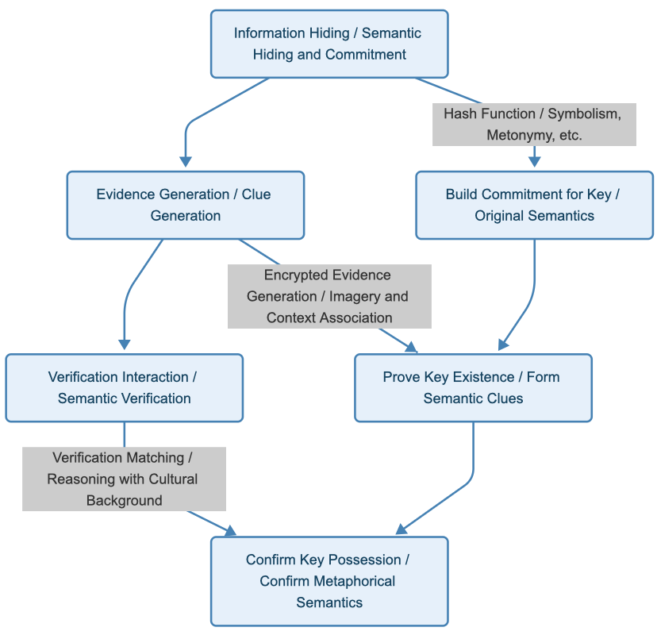
Zero-knowledge proofs (ZKP) & metaphor
Zero - Knowledge Proofs (ZKP) Basics
Definition: Do not disclose plaintext, only prove that 'I know' certain information.
Key Elements:
Prover generates proof(zk-SNARKs/R1CS circuits and polynomial commitments)
The verifier checks whether the proof is valid(elliptic curve pairings and hash-based challenges)
The information itself is not exposed(cryptographic commitments)
ZKP in Metaphor:
Just as ZKP protects digital secrets, metaphors protect the original semantic meaning of a message.
Notes:
So after we know the shared features, how can we design a further extracted model? We choose to combine Zero - knowledge proofs (ZKP) with metaphors.
ZKP’s definition is simple yet powerful: they let you prove you know certain information without disclosing the actual plaintext. It's like proving you have the key to a treasure chest without showing the key itself.
There are three key points. First, the prover generates a proof using algorithem like zk - SNARKs, R1CS circuits, and polynomial commitments. Then comes the verifier checks if the prover's code is legit, using methods like elliptic curve pairings and hash - based challenges. And the actual information stays under the commitments.
In this picture, we can see how metaphors follow the same structure in hiding creative ideas, protecting the original semantic meaning of a message.

Slide 6
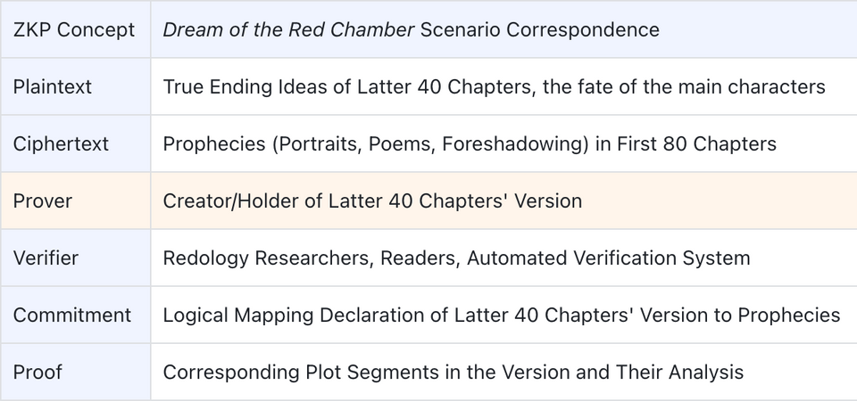
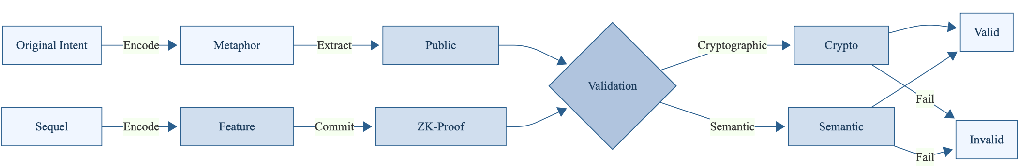
An example of Dream of the Red Chamber
The authorship of the last 40 chapters has been debated for centuries(Chenggao version VS Guiyou version).
We hope to design a system that can both protect text privacy and verify logical authentication.
Use NLP to extract text features and analyze the semantic consistency.
Use ZKP to implement privacy protection verification.
Notes:
Now, let's dive deeper into our example of Dream of the Red Chamber.

Slide 7
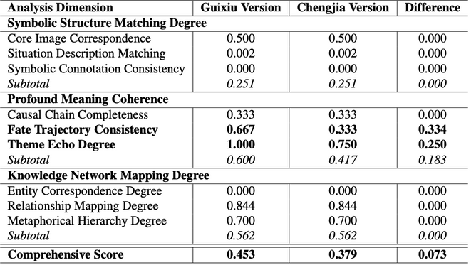
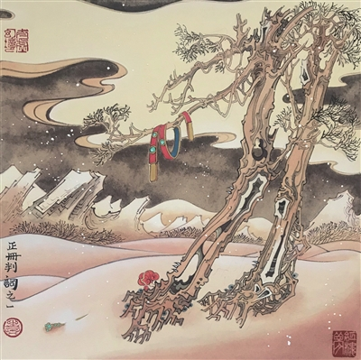
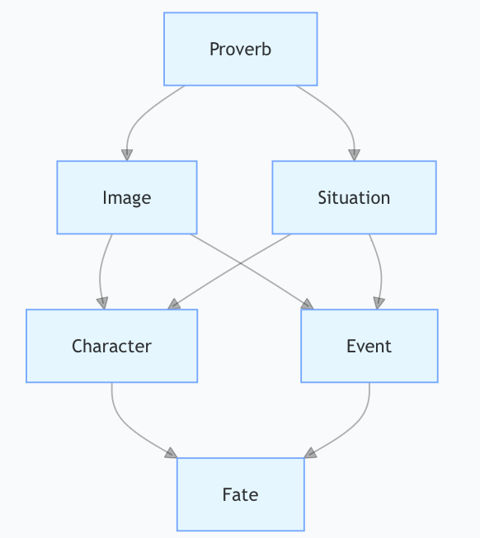
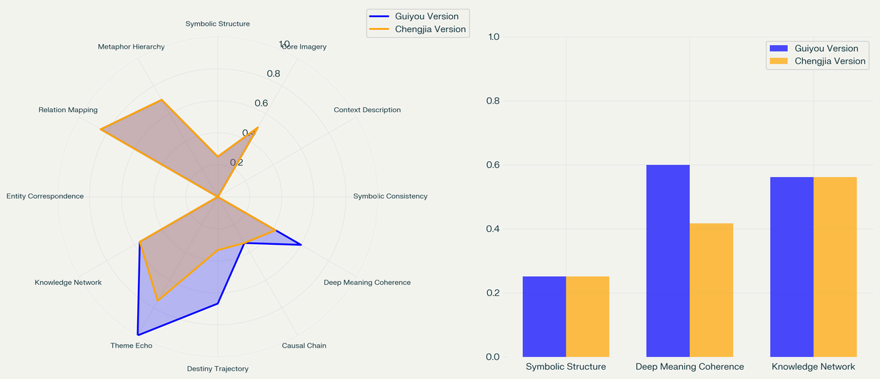
Encryption of prophecies
e.g. The class metaphor/prophecy in "金簪雪里埋" - "gold hairpin buried in snow"

Slide 8
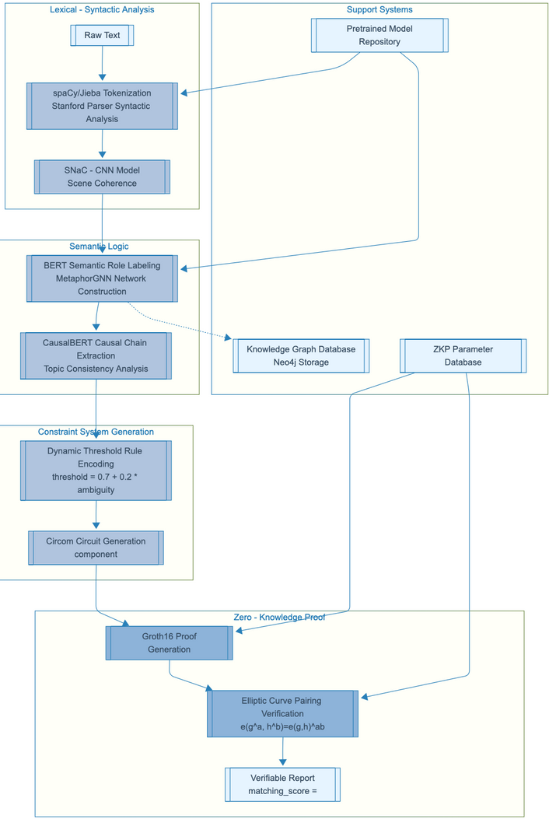
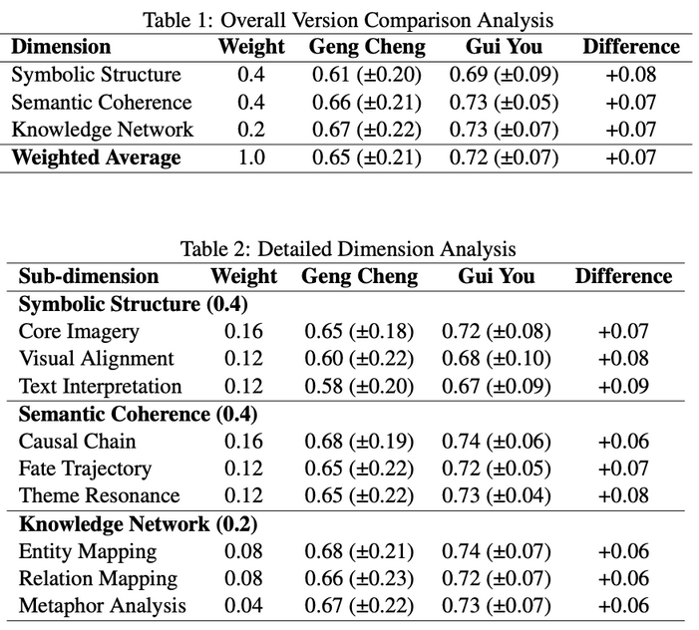
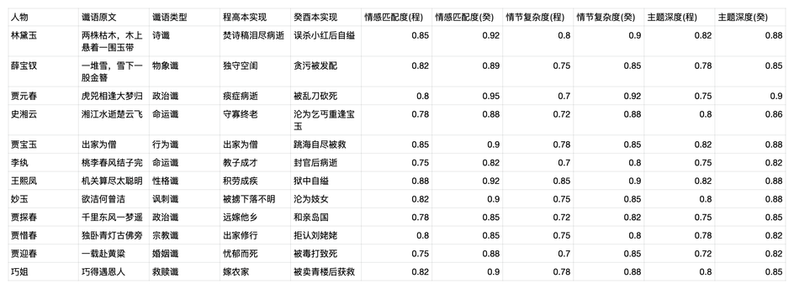
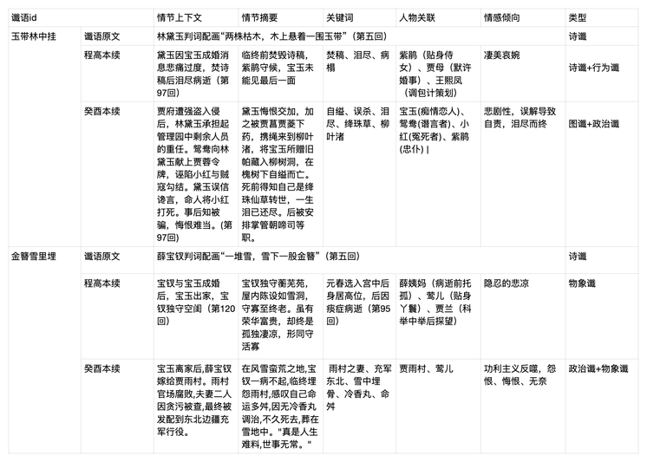
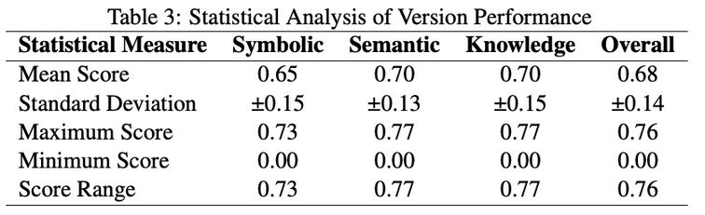
Decryption of prophecies
Expand the dataset to include all core prophecies
Notes:
Now that we've looked at the encryption of prophecies, let's move on to their decryption.

Slide 9
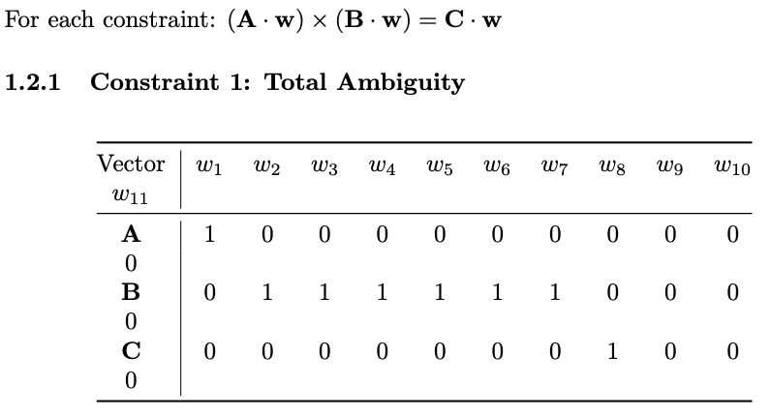

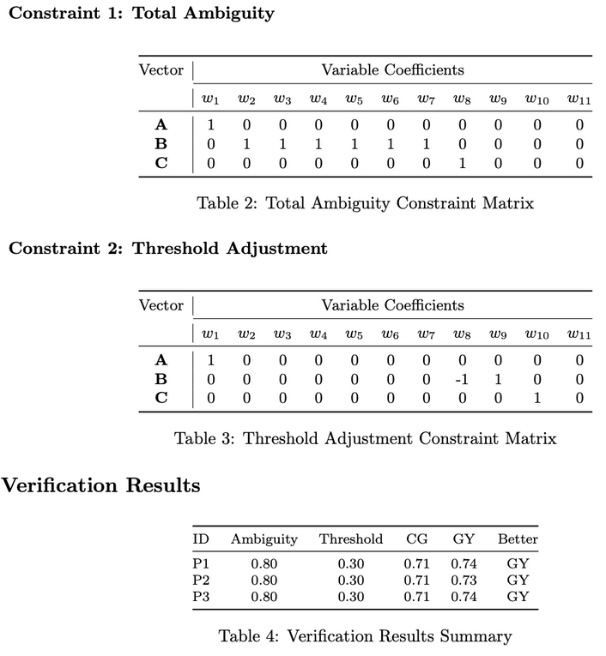
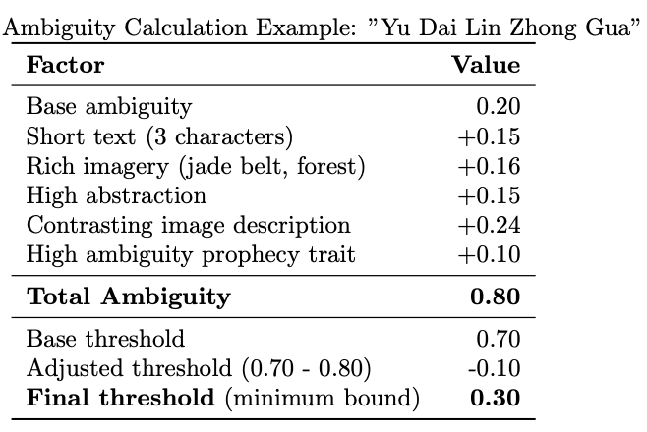
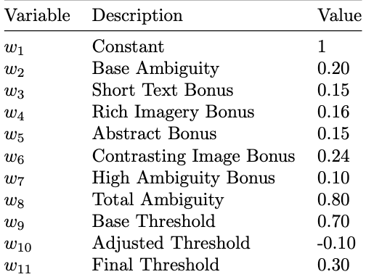
Constraint system generation
Prophecy Ambiguity and Threshold Calculation
Formulating R1CS Constraints
Based on each prophecy
dynamically generate its ambiguity data to determine the threshold
threshold = 0.7 + 0.2 * ambiguity
Notes:
Now, we're moving on to the ZKP calculations. First, we wanted to map the NLP data into a circuit system to create constraints. To do this, we used formulas for ambiguity and threshold. Since the encryption levels of different prophecies vary, we designed a dynamic matching of ambiguity and threshold.
We took an example and calculated the weights for each dimension. Then, we used the R1CS formula to convert it into three vector matrices. These matrices are used to check the constraint conditions of the prophecy.

Slide 10
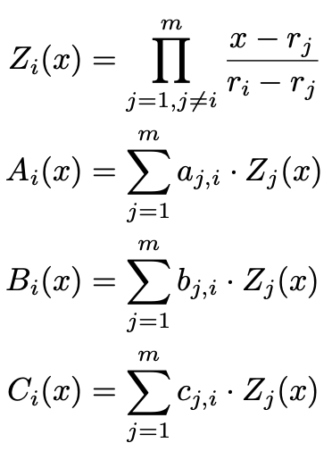
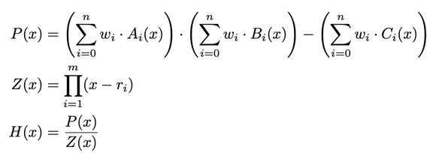
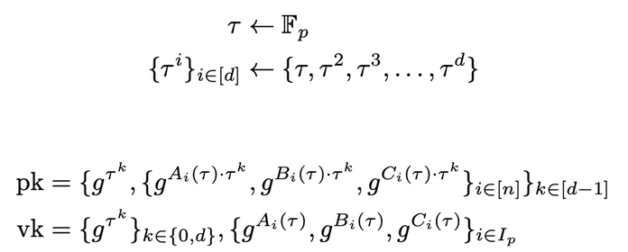
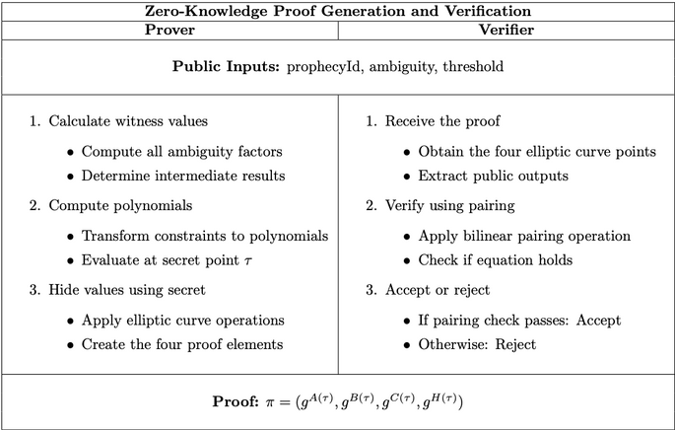
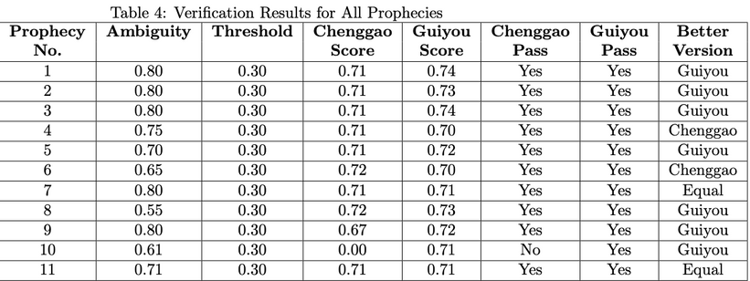
Zero knowledge proof process
R1CS to QAP Transformation
QAP Polynomial System
Trusted Setup and Key Generation
Z_i (x) is a Lagrange basic polynomial, which is equal to 1 at a specific point and 0 at other points
A_i (x), B_i (x), and C_i (x) are polynomials obtained through matrix transformation
P (x) represents the validation polynomial, which checks whether the R1CS constraint is satisfied
Z (x) is a vanishing polynomial, equal to 0 at all constraint points
H (x) is a quotient polynomial, and the constraint is only satisfied when P (x) can be divided by Z (x)
Proof Generation Process
Notes:
After setting up these constraints, we move on to the zero - knowledge proof process.
First, we have the R1CS to QAP transformation. Here, we use Lagrange basic polynomials, It's designed to provide a mathematical way to verify the integrity of our constraints
At this table, we expand the dataset to the all prophecies, we can see the QAP result.
Next is the trusted setup and key generation. We choose a value τ from a finite field Fp​ and generate a set of values based on it. Then we create the public key pk and the verification key vk, they are designed to make sure that the zkp works properly and that information wouldn’t be leaked.

Slide 11
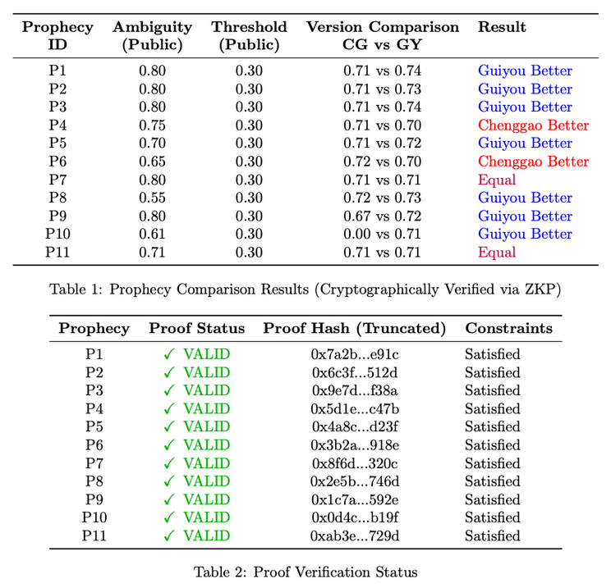
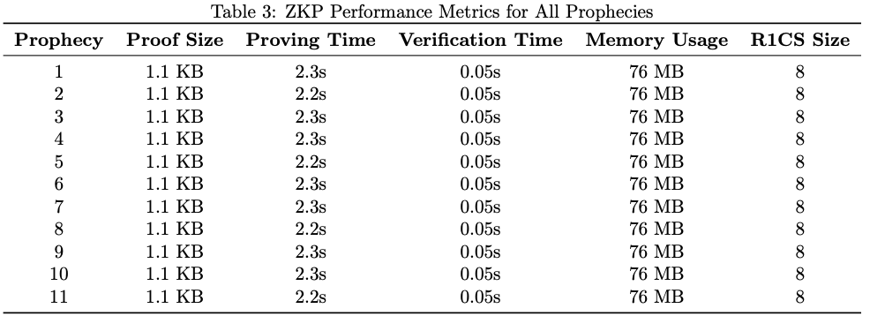
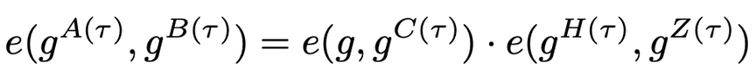
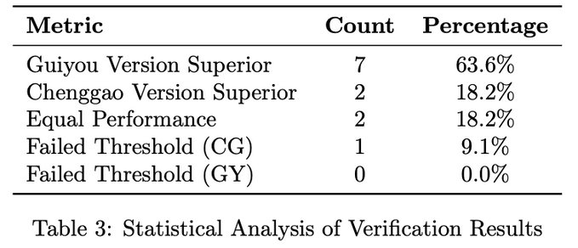
Circuit performance and results
Performance data of the system processing prophecies
Generate once, verify multiple times
Verification Equation
Verification job:
Just calculate whether this equation holds or not
No need for raw data:
validators do not need to know any private computing details
Notes:
Finally we can look at the circuit performance and results.
Our system follows the rule of “Generate once, verify multiple times” so here the table show the performance and efficiency about the some metrics like proof size, time, verification time…
When comparing the Chenggao (CG) and Guiyou (GY) versions, we find that most proofs are valid and the constraints are met.
In summary, our system demonstrates high efficiency and provides clear insights into which version of the novels prophecies is more in line with our analysis.

Slide 12
Further applications
Cultural Heritage Preservation
Validates provenance of historical texts without exposing fragile or sacred original materials.
Measure feasibility and restoration.
Commercial Bidding
Define evaluation factors for bids.
Ensure fairness and choose suitable bids.
Criminal Investigation
Assess clues with the model.
Analyze reliability and relevance. Verify clues privately like the model does, aiding investigations.
Blockchain Transactions
Verify transactions without disclosing sensitive info like amounts and identities, ensuring security and preventing fraud.
Notes:
So besides, we can apply the system in to the other aspects of our real life, such as the Cultural Heritage Preservation, Commercial Bidding, Criminal Investigation as well as Blockchain Transactions.

Slide 13
Thanks for your listening
Q&A
Lian, Zihe Zhao, Ayizuorehe
AI Thrust, Info Hub, HKUST(GZ)
xlian289@connect.hkust-gz.edu.cn

